Slide 1
OAS zimski semestar
Predmet: Linija četvrta nedelja
I godina
Predmet: Linija
Vanr. profesor Ana Cerović

Slide 2
Rembrandt Van Rijn crteži
Rembrandt Van Rijn (1606.-1669. ), veliki holandski slikar baroka
https://en.wikipedia.org/wiki/Rembrandt
Kao majstor koji se služio masama tamnog i svetlog može se navesti Rembrandt. Iako je to važno sredstvo njegovog izražavanja on ne zanemaruje liniju , i u mnogim njegovim crtežima daje joj veliki značaj.

Slide 3
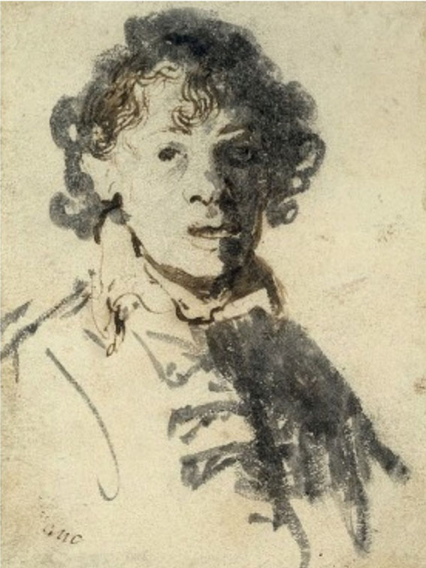
Rembrandt van Rijn,
Self-portrait,
Pen and bistre, brush and Indian ink, 12.7x9.5cm, about 1629.

Slide 4
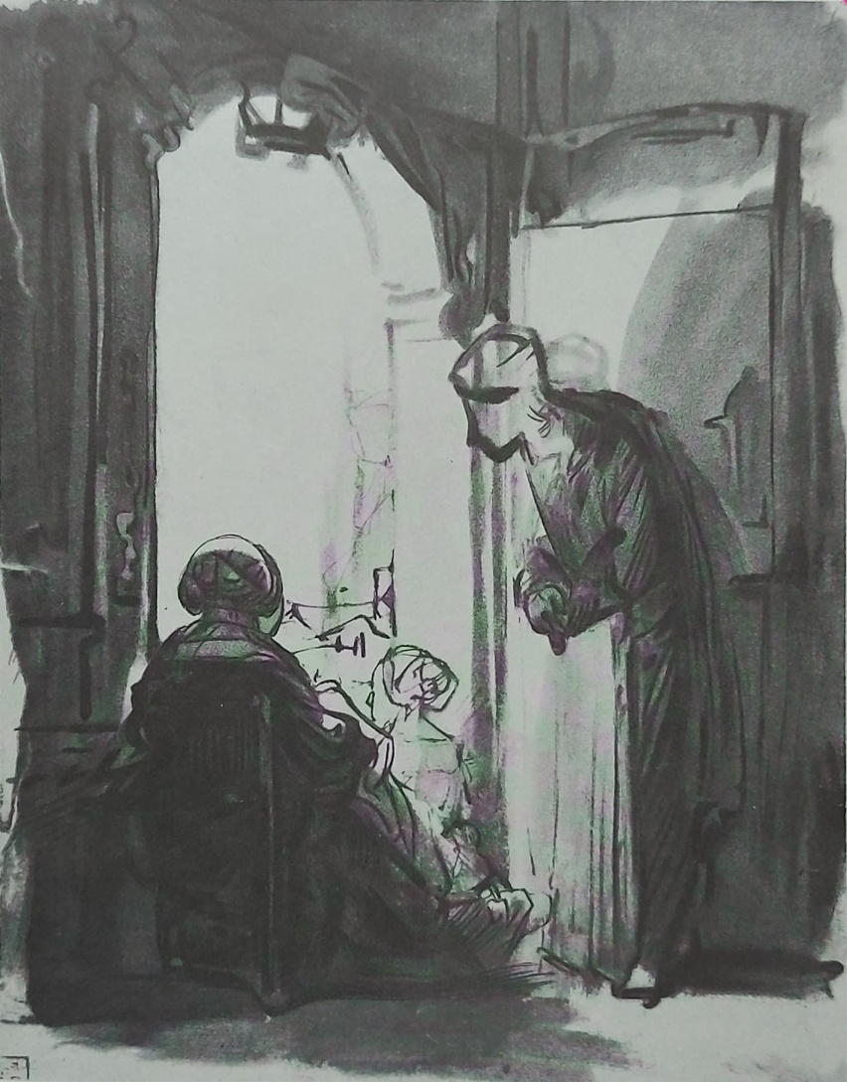
Rembrandt van Rijn,
Three Women Looking Out from an Open Door, brush, pen and wash, 25x19cm, about 1635-45.

Slide 5
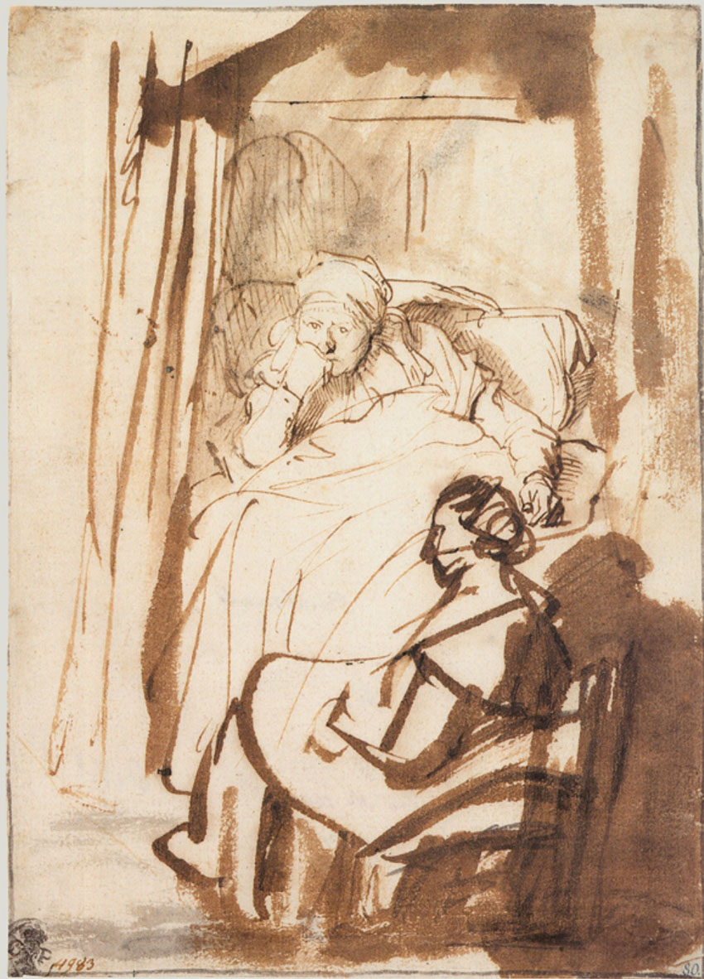
Rembrandt van Rijn,
Saskya Lying in Bed, a Woman Sitting at her Feet, brush, pen and wash in bistre, and some Indian ink, 22.8x16.5cm, about 1635-38.

Slide 6
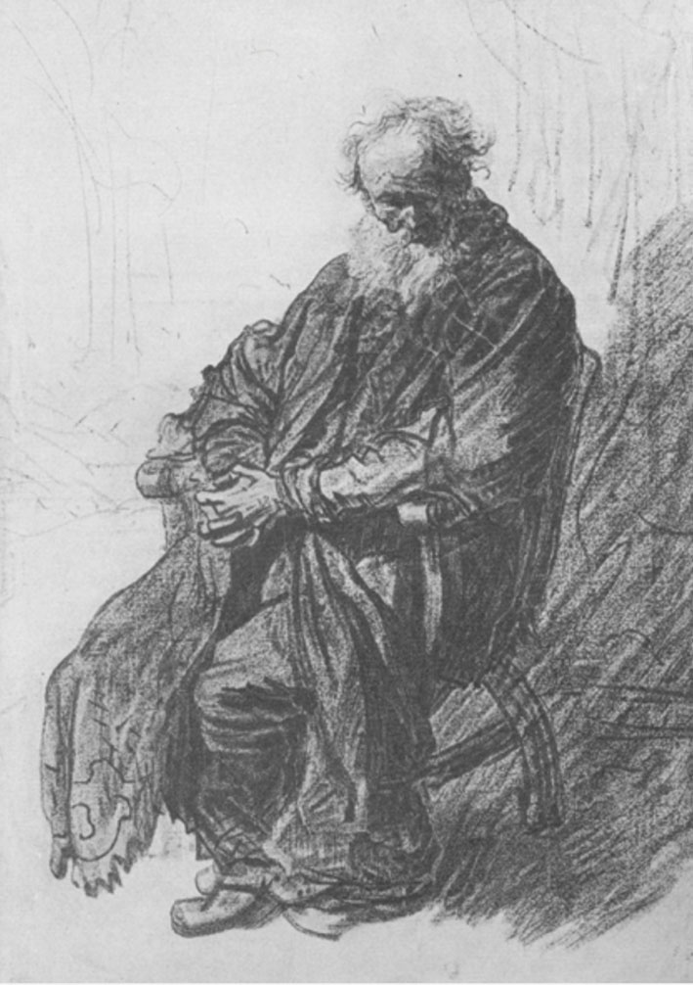
Rembrandt van Rijn,
Old Man Seated in an Armchair, red and black chalk,
22.6x1 .7cm, 1631.

Slide 7
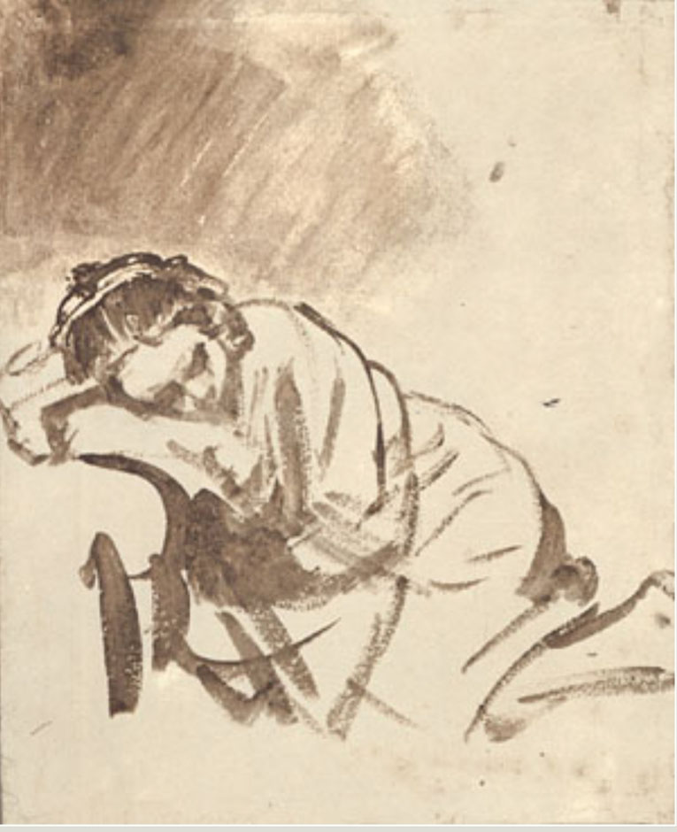
Rembrandt van Rijn,
A Woman Sleeping, brush and wash in bistre, 24.5x20.3cm, about 1655.

Slide 8
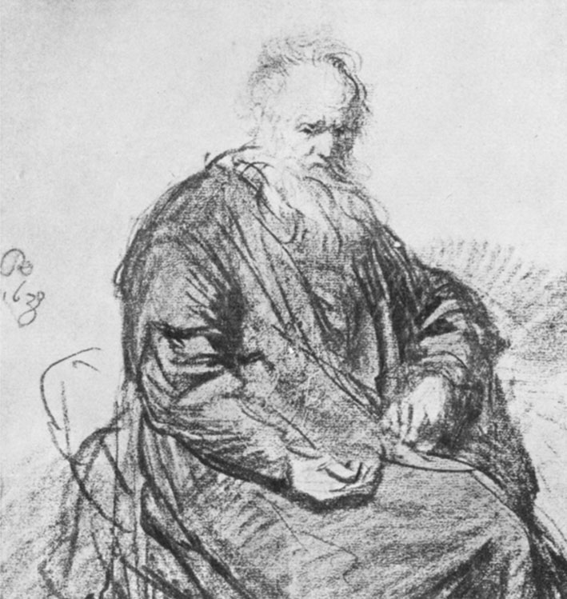
Rembrandt van Rijn,
Seated Old Man, red chalk, 15.7x14.7cm, 1630.

Slide 9
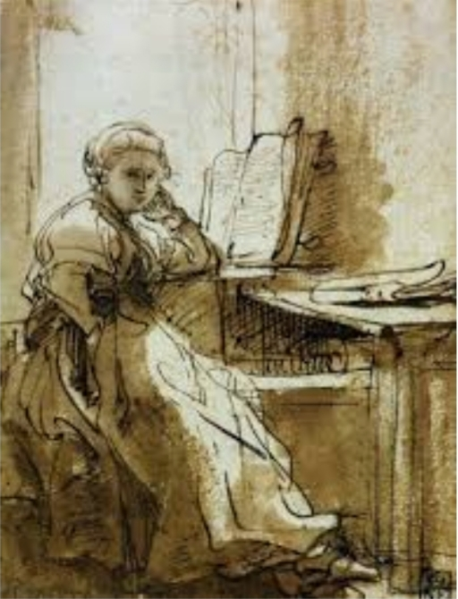
Rembrandt van Rijn,

Slide 10
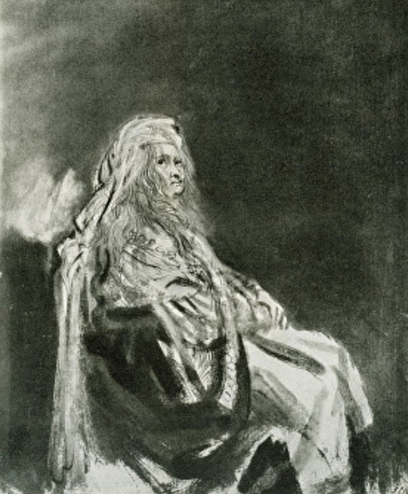
Rembrandt van Rijn,
Woman Seated, in an Oriental Costume, brush, pen and wash, white body color, 20x16.2cm

Slide 11
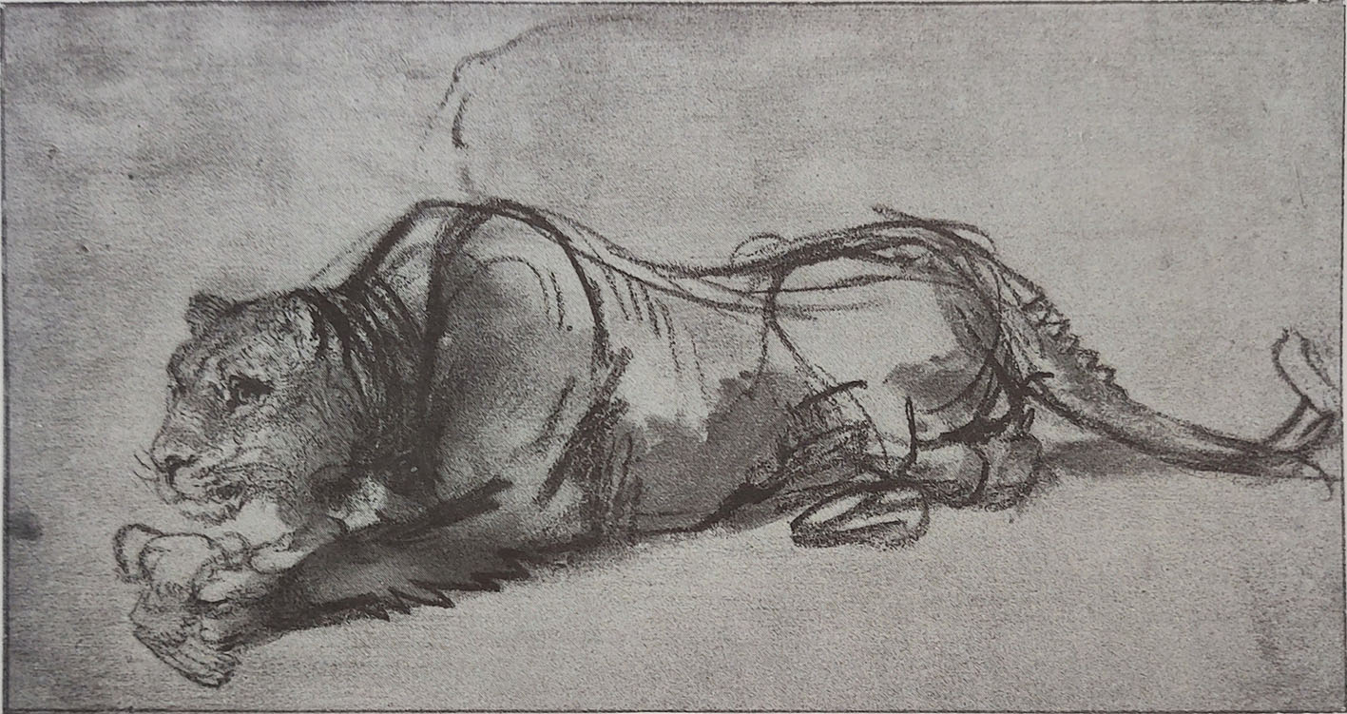
Rembrandt van Rijn,
Lioness Eating a Bird, black chalk and Indian ink wash, heightened with white, 12.7x23.8cm,

Slide 12
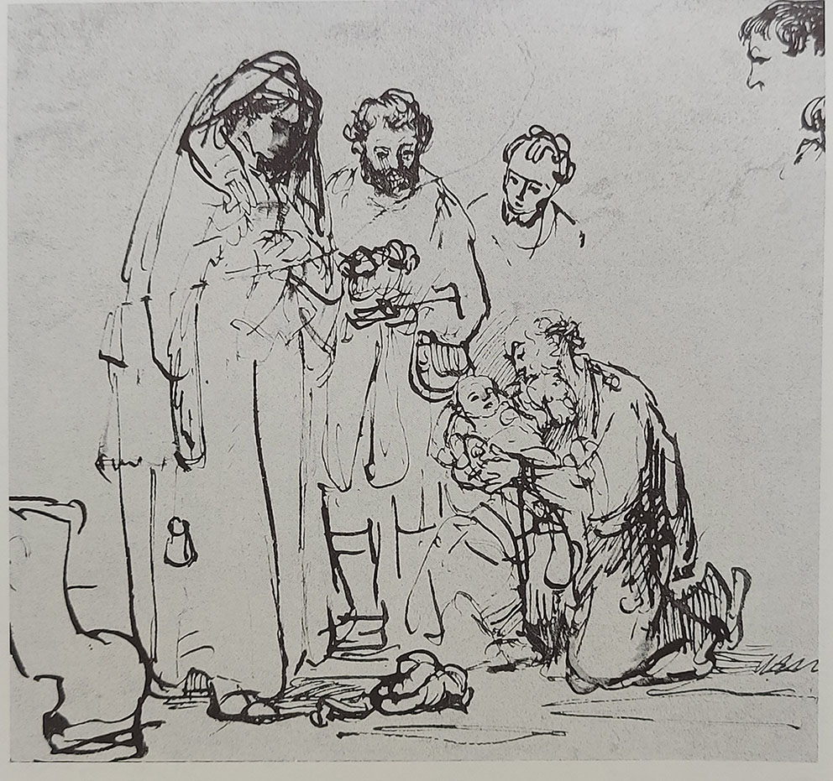
Rembrandt van Rijn,
The Presentation in the Temple, pen and bistre, 18x19cm, about 1640.

Slide 13
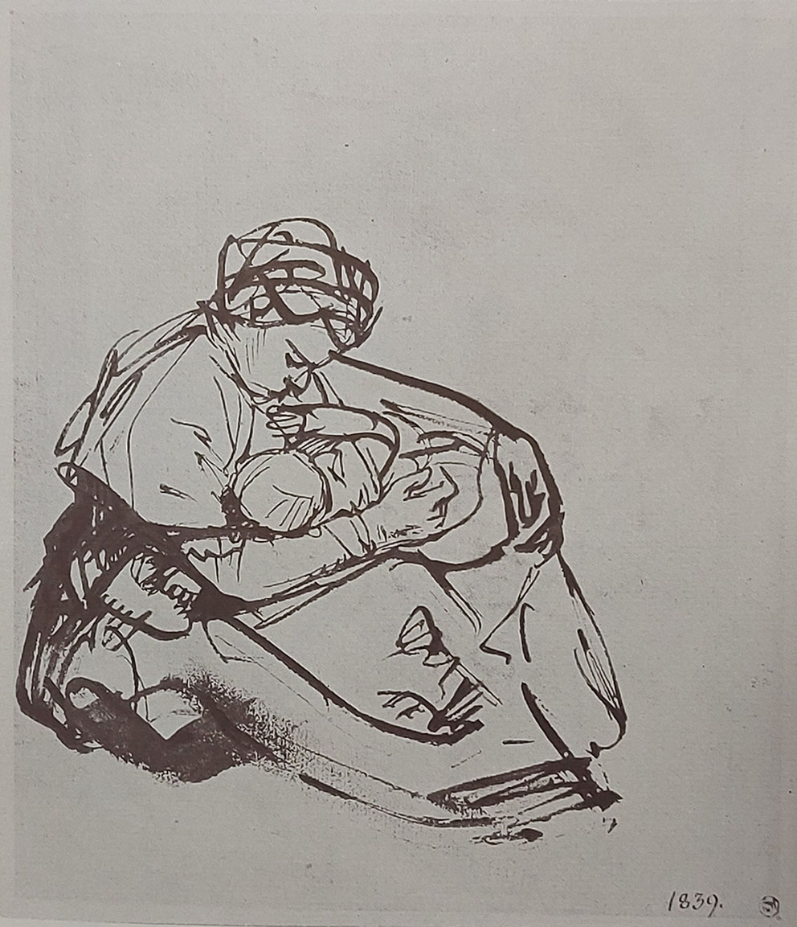
Rembrandt van Rijn,
A Woman Seated on the Ground Suckling a Child,
Pen and bistre, 17.5x15.3cm, about 1635-40.

